Slide 1
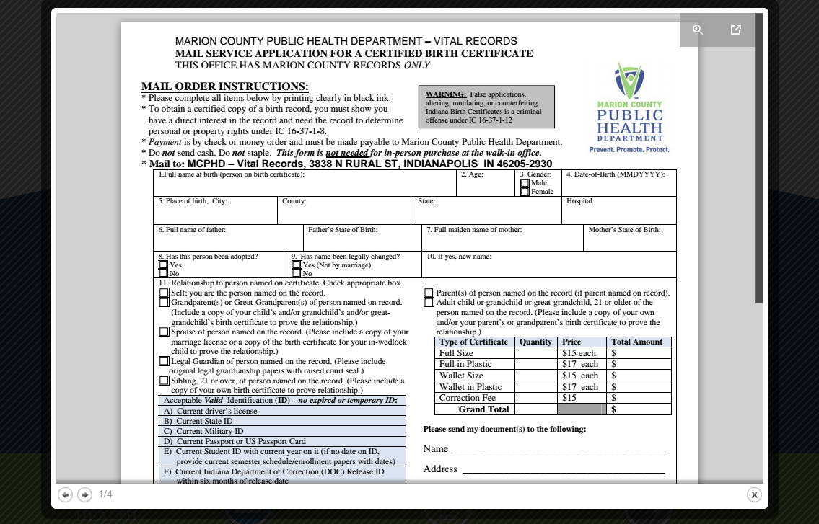
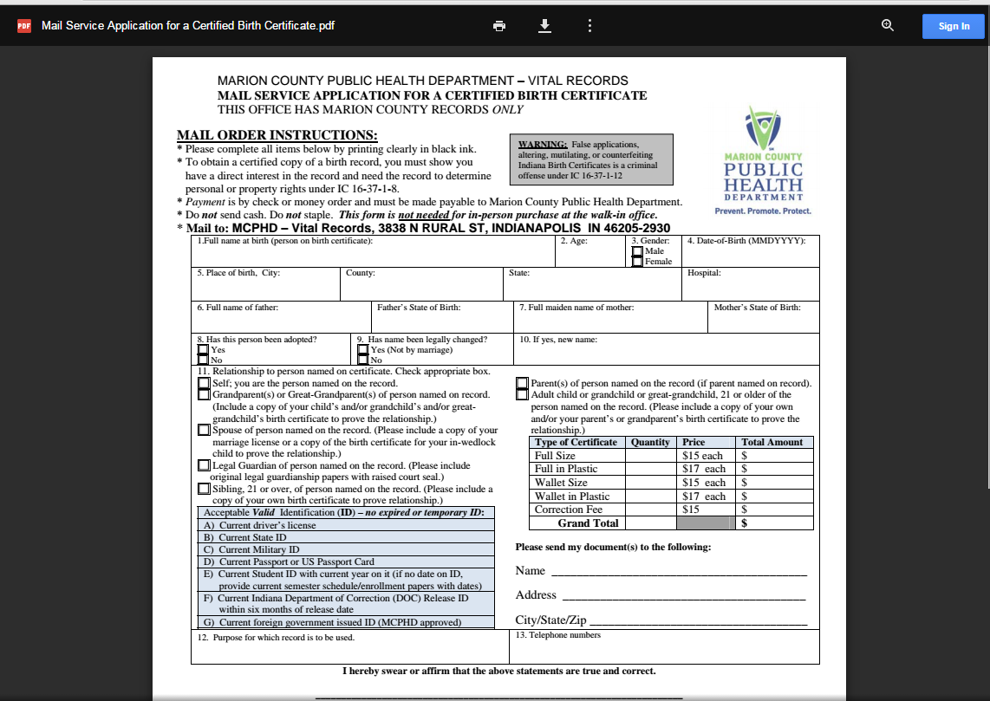
Step 1: Click on this button
Step 2: You can print from the printer icon or download the form to your computer.

